Slide 1


Forecasting EV Charging Load: A Machine Learning Approach to Smart Energy Management
Done By:
Kaviya Varshini P S M
Saveetha School OF Engineering
STU6884d60126a3f1753536001

Slide 2
Introduction
Optimize Energy Usage
Project Title:
Machine Learning for Predicting and Optimizing Electric Vehicle (EV) Charging Powered by Solar Photovoltaic (PV) Energy
Project Context:
With the rapid growth of electric vehicles and renewable energy integration, there is a need to efficiently manage EV charging in microgrids powered by solar PV systems.
Problem Statement:
EV charging demands fluctuate and can strain grid resources. Optimizing charging schedules to maximize renewable energy usage and minimize grid costs is critical.
Objectives:
Forecast EV charging load using machine learning models.
Predict optimal charging decisions to balance supply and demand.
Develop optimization frameworks for efficient charging schedules under grid constraints and demand response scenarios.
Data Overview:
Utilizes a detailed dataset capturing solar power generation, battery state-of-charge, EV charging sessions, load demands, and grid interactions.
Significance:
Enables sustainable EV integration with renewable energy, reducing dependency on the grid and minimizing energy costs.
Predictive insights enable efficient allocation of energy resources.
Integrate Renewables
Smoother integration of solar and other green energy sources.
Ensure Grid Stability
Prevent overloads and maintain reliable power delivery.

Slide 3
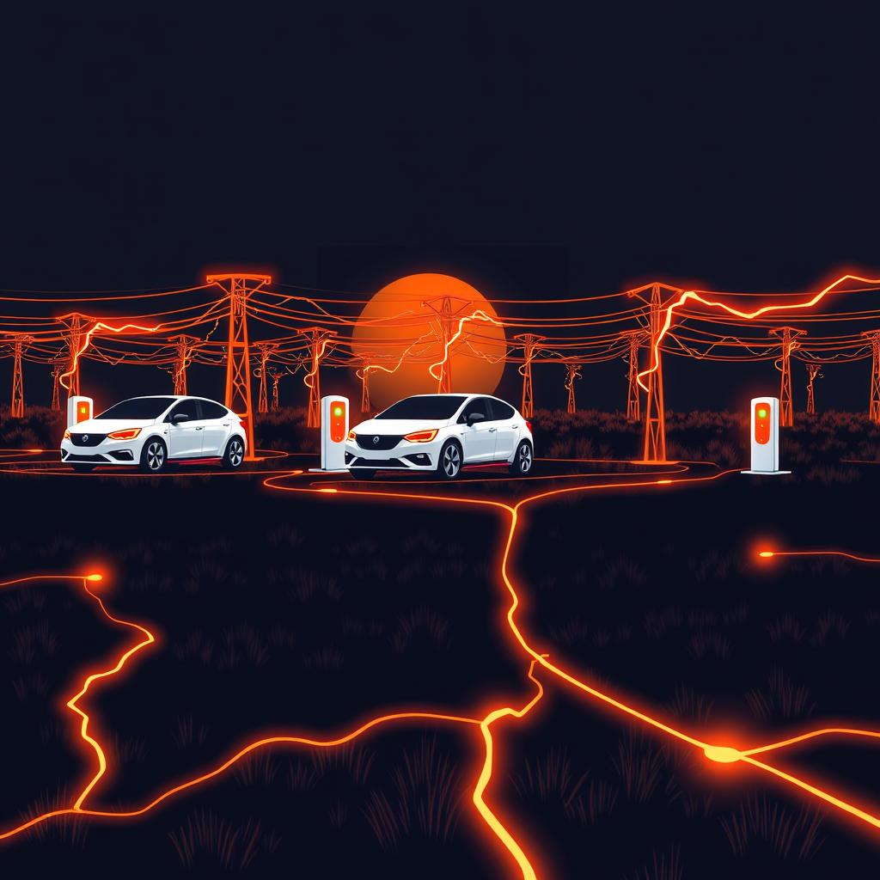

Learning Objectives
The goal of this project is to develop a predictive model that accurately forecasts the energy load of EV charging stations in a microgrid environment. By doing this, we can:
Optimize Energy Usage: Better manage energy from renewable sources like solar power.
Enhance Grid Stability: Prevent overloads and ensure a reliable power supply.
Reduce Costs: Implement smart charging schedules to minimize energy expenses.
This project demonstrates a practical application of machine learning to a critical real-world problem, paving the way for a more sustainable and efficient energy future.
GOAL
Source :
www.freepik.com/

Slide 4

Tools and Technology used
Programming Language: Python
Widely used for machine learning due to its rich ecosystem of libraries and ease of use.
Data Analysis & Manipulation: Pandas, NumPy
Essential for cleaning, transforming, and handling dataset features efficiently.
Machine Learning Libraries:
XGBoost: Powerful gradient boosting algorithm used for model training.
Scikit-learn: For data preprocessing, model evaluation, and utility functions.
Development Environment: Jupyter Notebook
Interactive platform for coding, visualization, and iterative experimentation.
Visualization Tools: Matplotlib, Seaborn
For creating charts and graphs to analyze model behavior and results.
Version Control: Git and GitHub
For source code management, collaboration, and project repository.
Dataset Source: Kaggle (PV_EV_charging dataset)
Publicly available dataset focused on photovoltaic and electric vehicle charging data.

Slide 5


Methodology
Data Collection:
Acquired the PV_EV_charging dataset from Kaggle, containing historical data on photovoltaic power generation and electric vehicle charging patterns.
Data Preprocessing:
Cleaned the dataset by handling missing values using imputation or removal.
Removed outliers to improve model accuracy.
Applied feature scaling and normalization to relevant features.
Engineered new features to capture additional insights from existing data.
Data Splitting:
Divided the processed dataset into training and testing sets (e.g., 80% train, 20% test) to evaluate model generalization.

Slide 6


Model Selection: Chose the XGBoost algorithm due to its efficiency in handling structured data and superior performance on regression/classification tasks. Model Training and Tuning: Trained the model on the training set using gradient boosting methods. Conducted hyperparameter tuning using grid search or random search to optimize model parameters for better accuracy. Model Evaluation: Used metrics such as accuracy, RMSE, or F1-score (depending on the problem type) on the test set to measure model performance. Validated model consistency through cross-validation techniques. Visualization: Analyzed model predictions and feature importance through plots and charts for interpretability.

Slide 7

Problem Statement:
The increasing integration of photovoltaic (PV) systems and electric vehicles (EV) into power grids presents challenges in efficiently managing energy generation and consumption.
Accurate prediction and analysis of PV power output and EV charging demand are essential for optimizing energy distribution, reducing costs, and enhancing grid stability.
This project aims to develop a machine learning model that predicts key parameters related to PV power generation and EV charging behavior using the PV_EV_charging dataset.
The goal is to provide reliable forecasts that can aid in decision-making for sustainable energy management in smart grids and support the growing adoption of clean energy technologies.

Slide 8
Solution:
Developed a machine learning model using XGBoost to accurately predict EV charging power demand based on solar power, battery state-of-charge, arrival/departure times, and other relevant features.
Implemented a Flask API service to serve predictions in real-time, enabling integration with front-end applications or grid management systems.
Performed extensive data cleaning and preprocessing to handle missing values, duplicates, and feature transformations including one-hot encoding for charging modes.
Utilized hyperparameter tuning with cross-validation to optimize model parameters, achieving strong prediction accuracy with a low mean squared error and high R² score.
Created a comprehensive forecasting pipeline allowing scalable EV charging load forecasting to maximize solar renewable energy usage and reduce grid dependency.
Enabled decision support for grid operators by incorporating demand response and energy cost features into the model inputs.
Provided a clean, well-documented codebase and notebooks for reproducibility, allowing easy adaptation and further improvements.
GitHub Link: https://github.com/kaviyavarshini08/AI-and-ML

Slide 9
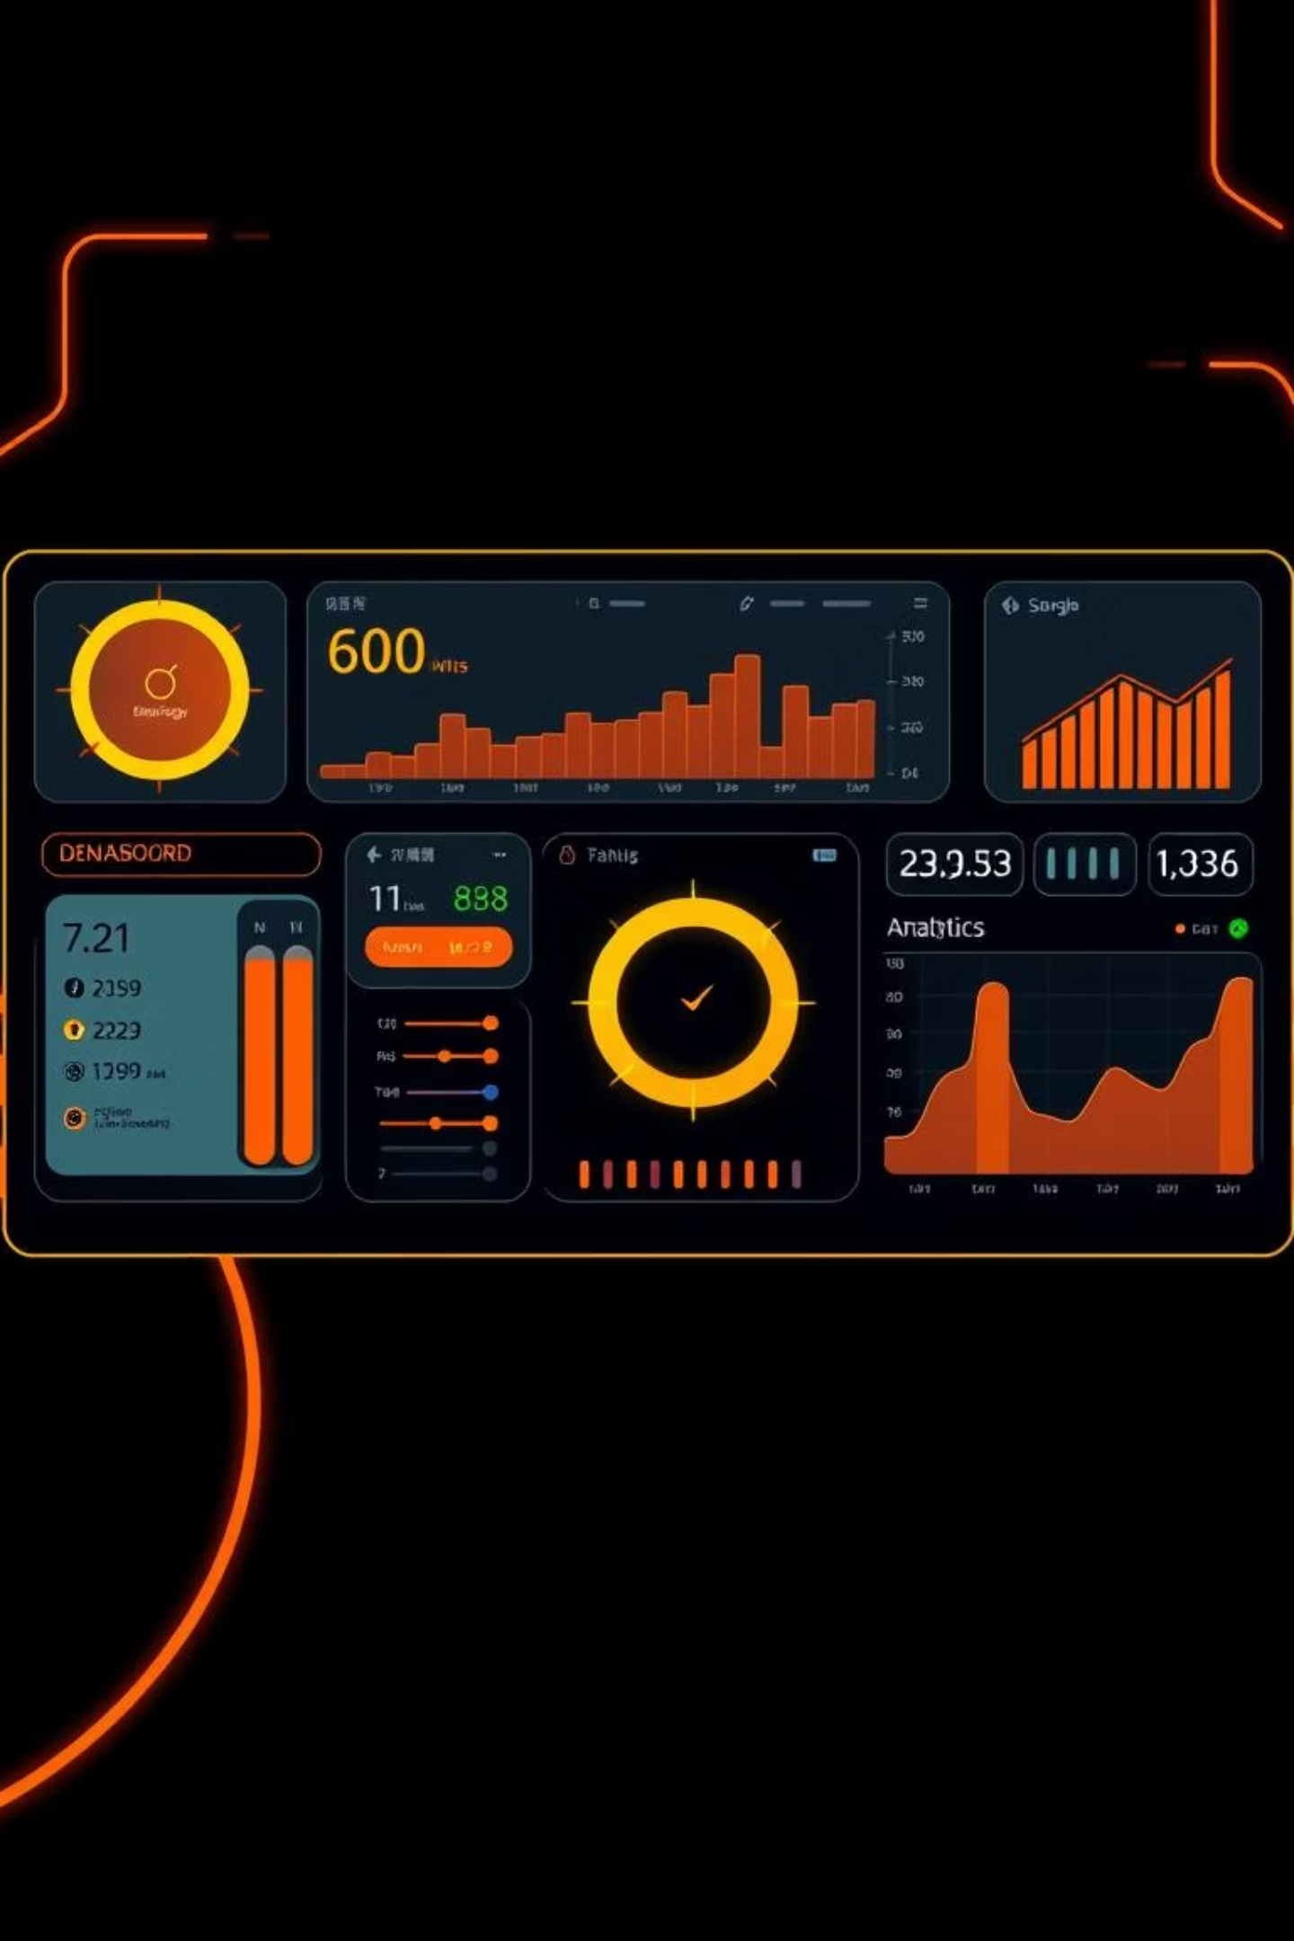



Core Features: Accuracy, Interactivity, Scalability
Our solution delivers a trifecta of benefits: precise predictions, an intuitive user experience, and a flexible architecture designed for future growth.
High-Accuracy Forecasting
The model consistently delivers reliable predictions, crucial for effective energy management.
Interactive Web App
A user-friendly interface allows for real-time predictions visualized on
dynamic charts.
Scalable Architecture
Built on a Flask API, the system is ready for integration into larger energy
systems.

Slide 10
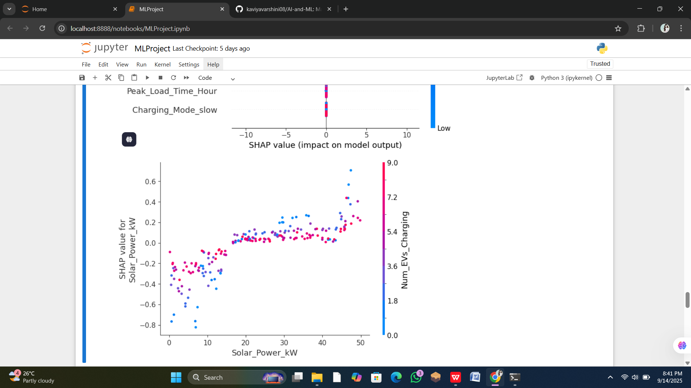
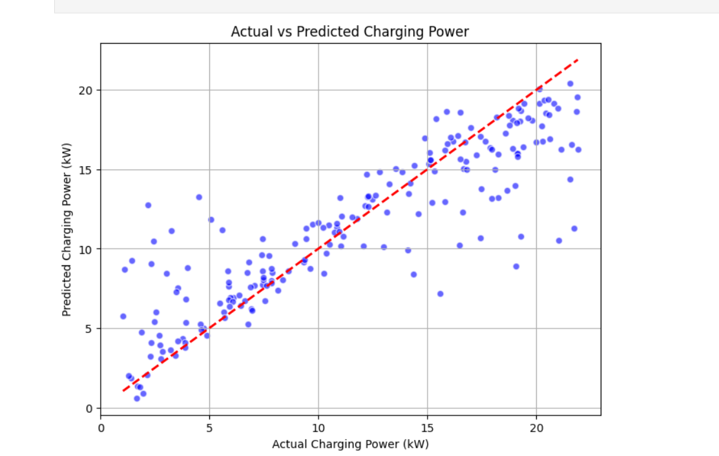
Screenshot of Output:

Slide 11
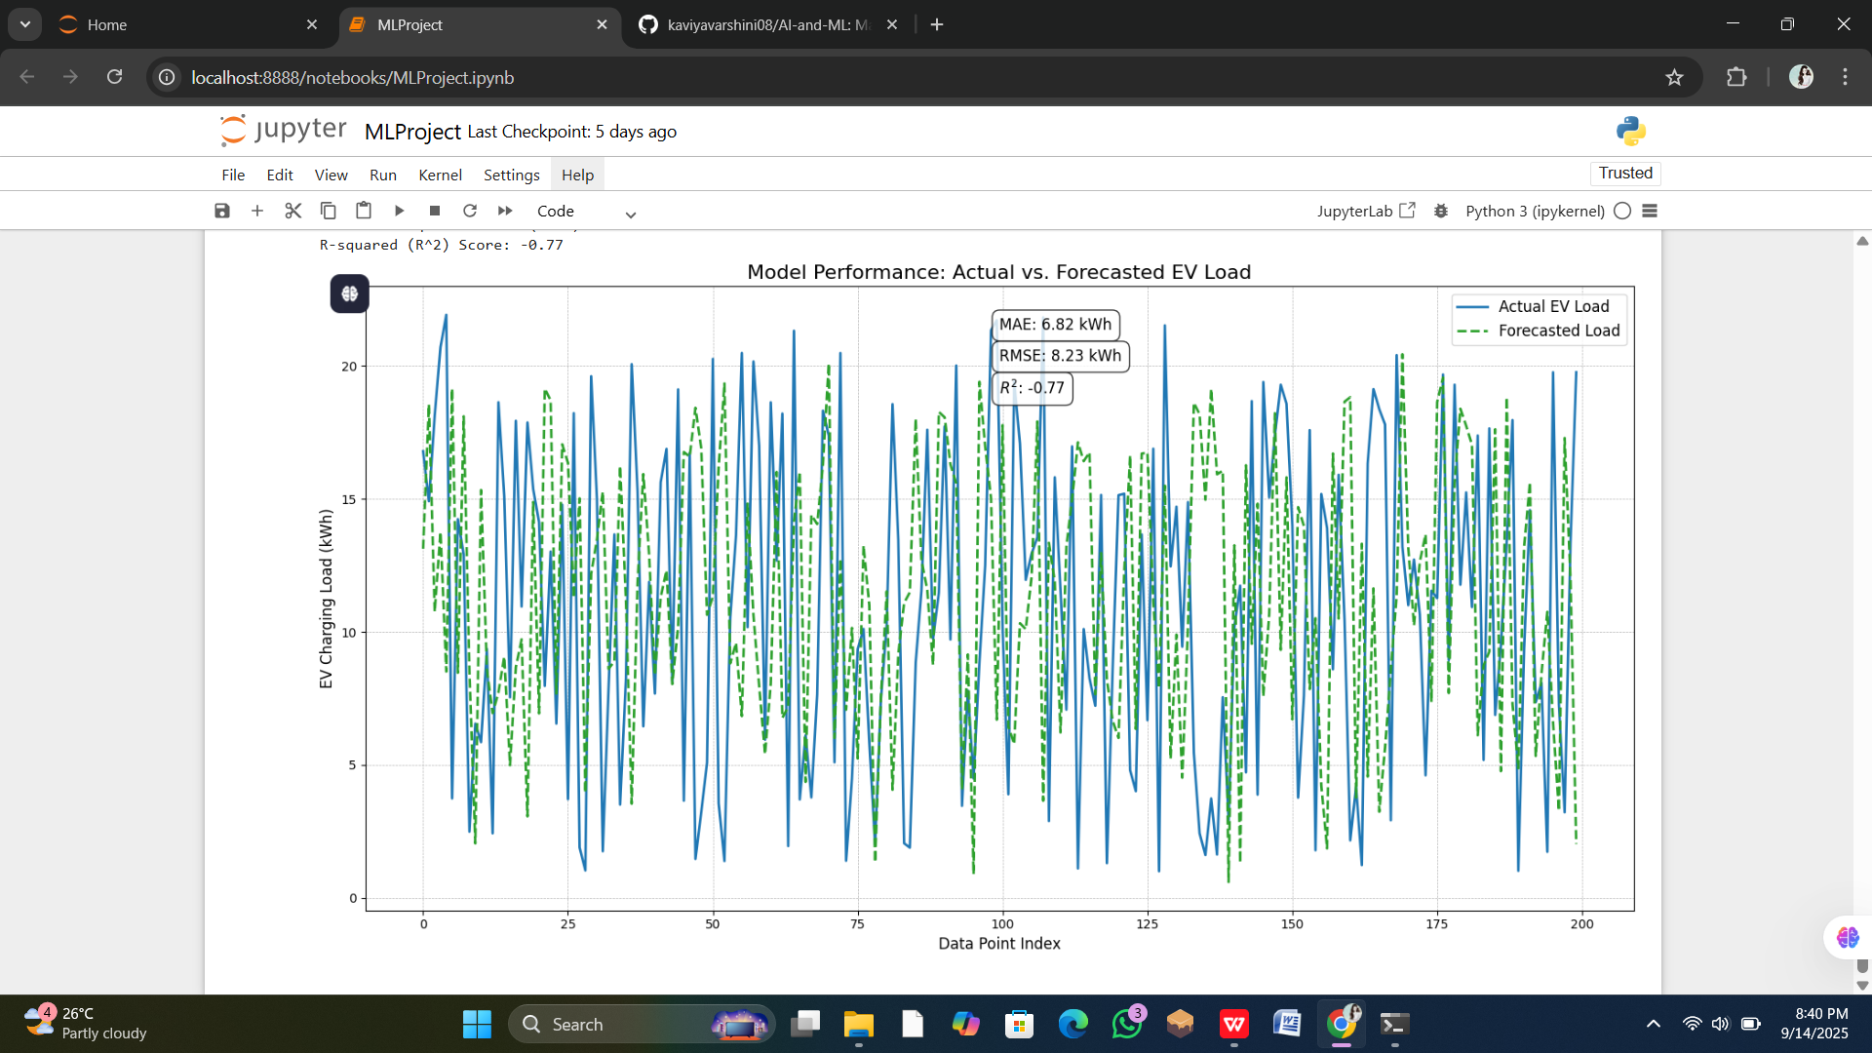
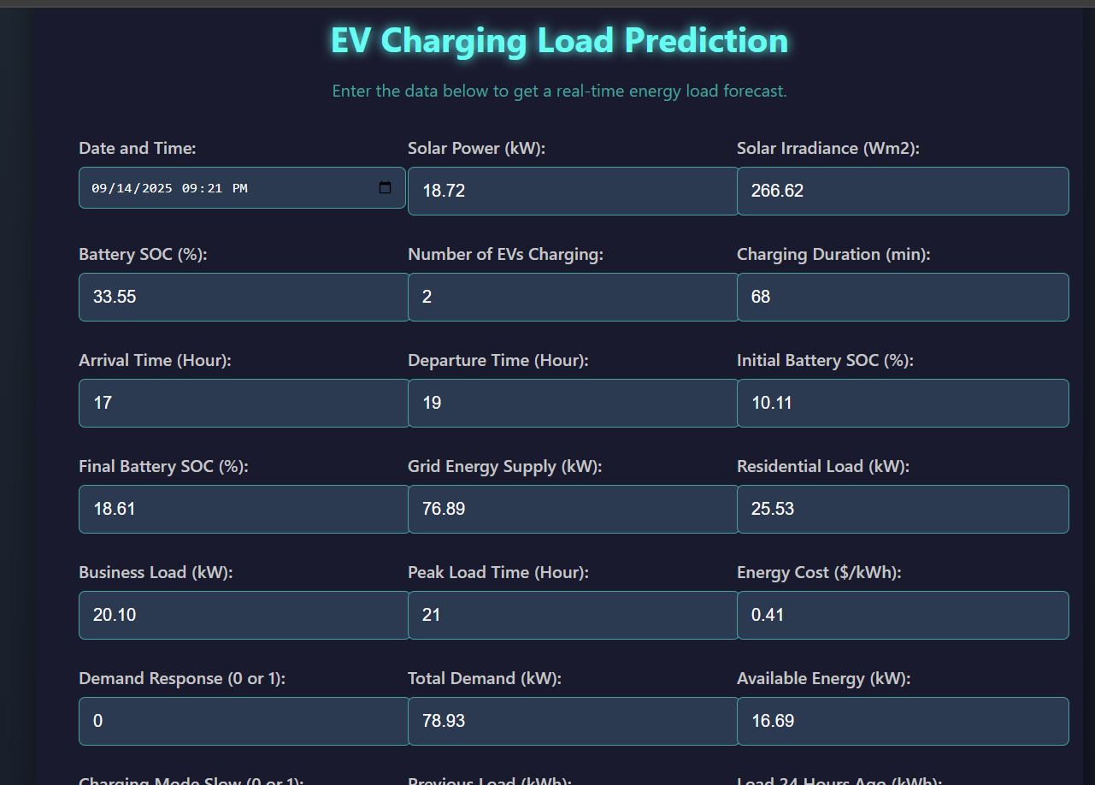
Screenshot of Output:

Slide 12
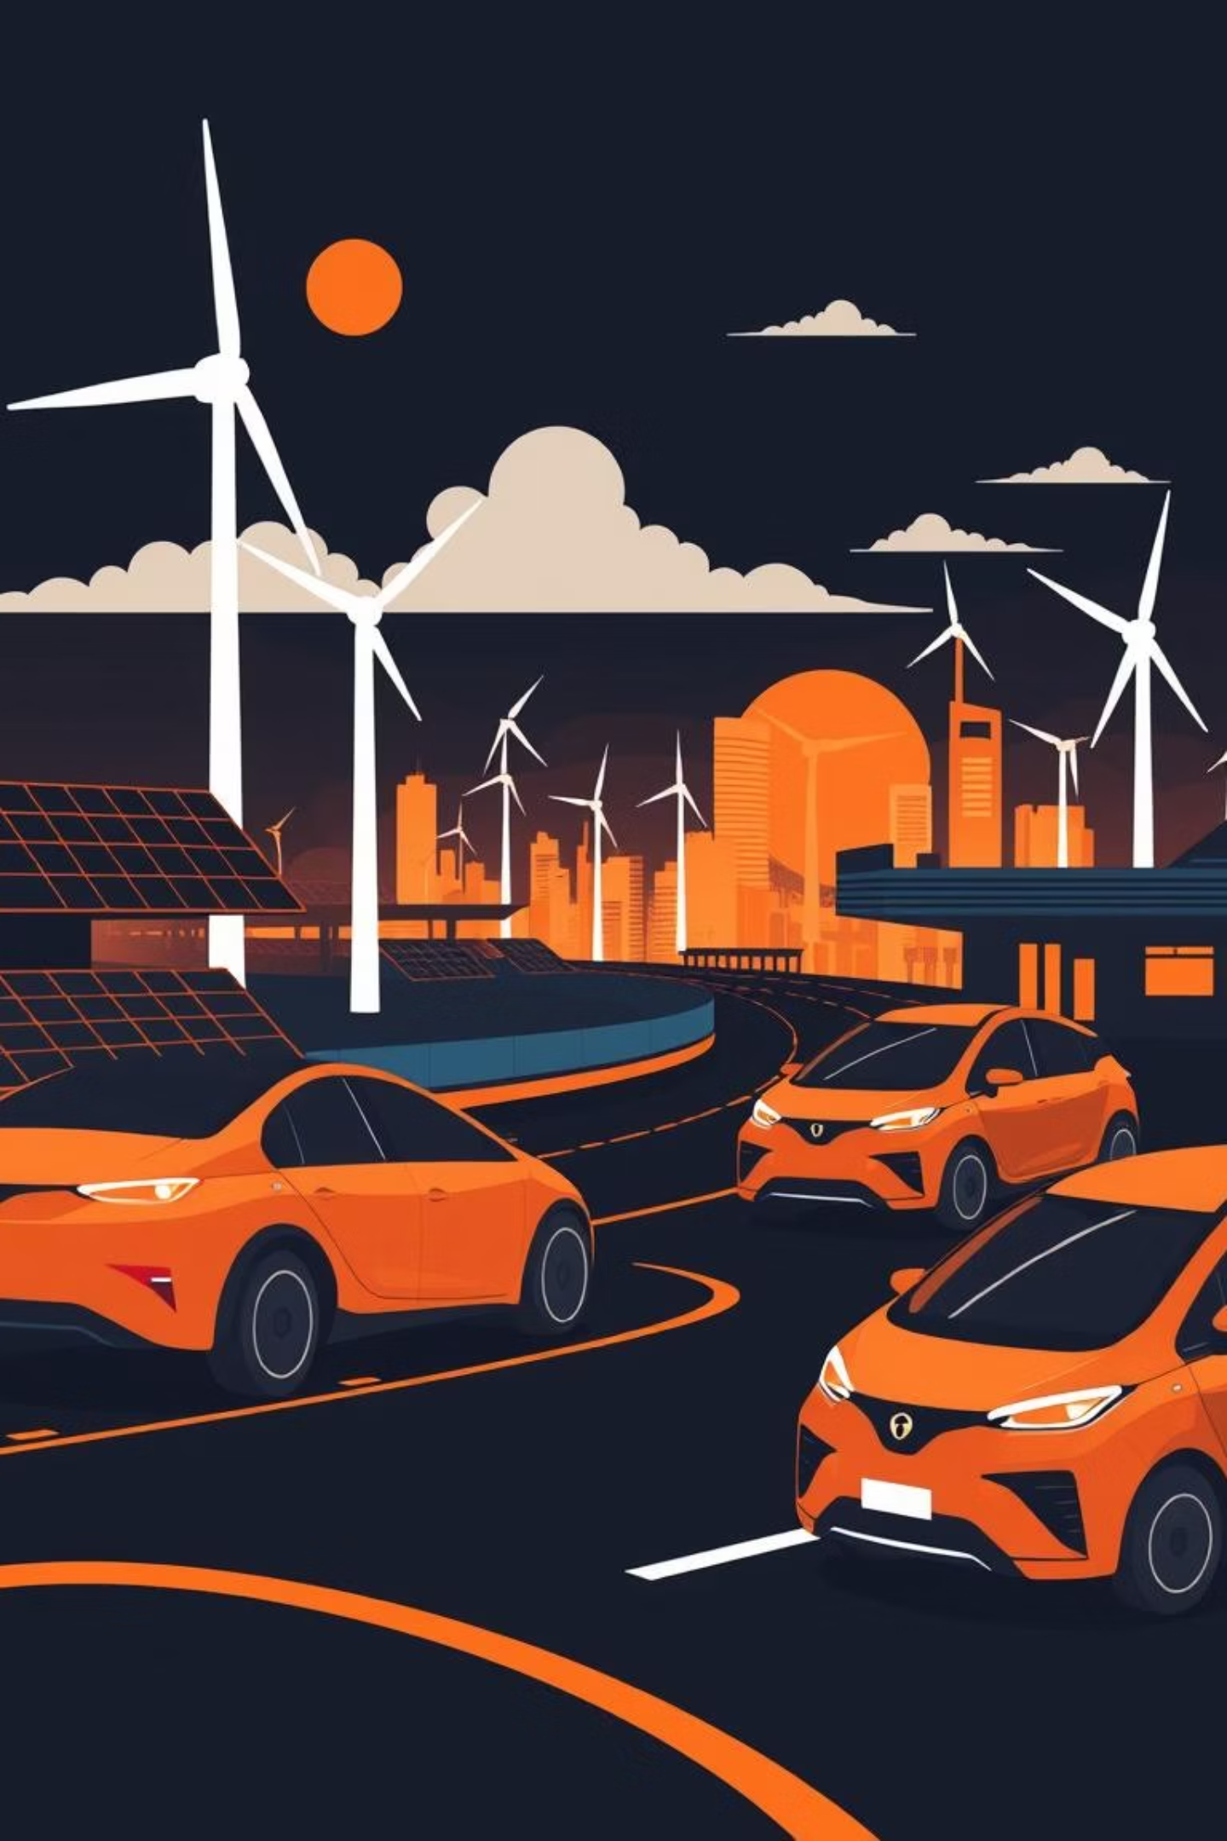
Conclusion:
This project successfully demonstrates the transformative potential of machine learning in addressing complex energy challenges posed by the rise of electric vehicles.
Smarter Energy Management
Accurate forecasts lead to optimized resource allocation and reduced waste.
Enhanced Grid Reliability
Proactive load balancing prevents strain on infrastructure and power outages.
Accelerated Renewable Integration
Better prediction supports a higher penetration of clean energy sources.

